Slide 1
Proposed ways of informing GPs about current services
Dr Louise Paterson

Slide 2
AIMS
What GPs need to know about CHD management and services
How to facilitate GPs education
Notes:
SV

Slide 3
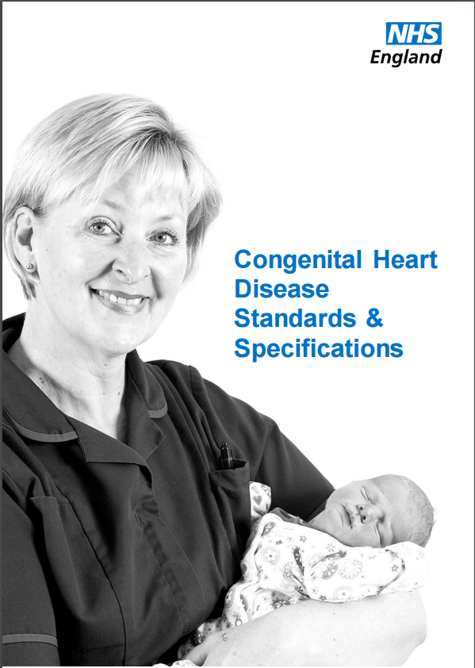
The Standards
Section A: The network approach
Section B: Staffing and skills
Section C: Facilities
Section D: Interdependencies
Section E: Training and education
Section F: Organisation, governance and audit
Section G: Research
Section H: Communication with patients
Section I: Transition
Section J: Pregnancy and contraception
Section K: Foetal diagnosis
Section L: Palliative care and bereavement

Slide 4
Standards
Discussion around the Standards may be helpful.

Slide 5

What does CHDN want GPs to be aware of?
Red flags for GPs
Temperature (endocarditis?)
Arrhythmia
Breathlessness
Signs of heart failure
Not gaining weight
Long term outcome of particular lesions
Medication, purpose and side effects
Requesting investigations

Slide 6

GP Survey
GPs were asked :
1) What do you want to know about CHD?
    Doctors educational needs (DENS)
    What we don’t know, we don’t know
2) Where would you look for advice about CHD?

Slide 7

Background to Survey
Email opportunist survey
24 respondents
Time period of 3 months
Most GPs were local but I also asked GPs in other areas in the UK
GPs ranged from very experienced GPs to trainees

Slide 8

GP survey findings - What GPs want to know
GP DENs
Management of acute illness - red flags, when to refer and when not to refer *
Mental health - supportive measures / medication / affects on family
Contraception
BP / Cholesterol
Pregnancy
Screening of future pregnancies and genetics
Transition to adult care
Palliative care
Long term outcomes of particular lesions*
Exercise / Sports - what patients should and should not do eg. diving
Managing multiple problems such as associated congenital abnormalities
* on CHDN list of what GPs should be aware of

Slide 9
GP survey findings - Were GPs look for specialist advice
Guidelines both National and Local
Consultant advise lines
Specialist nurses
Consultant secretaries
Medical internet sites
Ask other GPs
It can be time consuming, inefficient and ineffective

Slide 10
GP survey findings - suggestions for continued education
CHD website (national or local) for GPs with relevant information easily accessible
Specialist nurse advice : is already excellent and accessible
Information about both of the above on the bottom of discharge letters
Information on tertiary centres websites.
Information in local GP newsletters - eg gpmatters – RUH newsletter
Clinical meetings for GPs
GP training - clinical meetings
Video training
Online module training

Slide 11

HEADSSS
Home
Education / employment
Activity
Drugs
Sex
Suicide
Safety

Slide 12

What do we want GPs to be aware of?
Red flags for GPs
Temperature (endocarditis?)
Arrhythmia
Breathlessness
Signs of heart failure
Not gaining weight
Long term outcome of particular lesions
Medication, purpose and side effects
Requesting investigations

Slide 13

Lifestyle advice for Children GP need to be aware of
Diet
Exercise
Attend the dentist regularly
Risks of endocarditis
Plenty of rest
https://www.gosh.nhs.uk/.../helping-your-child-congenital-heart-disease-stay-healthy

Slide 14

Lifestyle for young people and adults that GPs need to be aware of
Healthy BMI
Exercise guidelines eg BHF www.bhf.org
Smoking avoidance
Safe drinking
Risk of recreational drugs
Regular dental care
Risk symptom and treatment of endocarditis
Medication, purpose, side effects and compliance
Contraception www.tsf.org
Pregnancy advice www.tsf.org

Slide 15
What can Level 1 offer? Discussion
Determine what GPs need to know
Determine how to facilitate GPs continued education

Slide 16
Contraception guidelines UKMEC
UKMEC SUMMARY TABLE HORMONAL AND INTRAUTERINE CONTRACEPTION
CONDITION | Cu-IUD | LNG-IUS | IMP | DMPA | POP | CHC
 | I = Initiation, C = Continuation
Valvular and congenital heart disease
a) Uncomplicated |  | 1 |  | 1 |  | 1 |  |  | 1 |  | 1 |  | 2
b) Complicated (e.g. pulmonary hypertension, history of subacute bacterial endocarditis) |  | 2 |  | 2 |  | 1 |  |  | 1 |  | 1 |  | 4
Cardiomyopathy
a) Normal cardiac function |  | 1 |  | 1 |  | 1 |  |  | 1 |  | 1 |  | 2
b) Impaired cardiac function |  | 2 |  | 2 |  | 2 |  |  | 2 |  | 2 |  | 4
Cardiac arrhythmias
a) Atrial fibrillation |  | 1 |  | 2 |  | 2 |  |  | 2 |  | 2 |  | 4
b) Known long QT syndrome |  | I | C | I | C | 1 |  |  | 2 |  | 1 |  | 2
 |  | 3 | 1 | 3 | 1

Slide 17
UKMEC contraception
UKMEC | Definition of category
Category 1 | A condition for which there is no restriction for the use of the method
Category 2 | A condition where the advantages of using the method generally outweigh the theoretical or proven risks
Category 3 | A condition where the theoretical or proven risks usually outweigh the advantages of using the method. The provision of a method requires expert clinical judgement and/or referral to a specialist contraceptive provider, since use of the method is not usually recommended unless other more appropriate methods are not available or not acceptable
Category 4 | A condition which represents an unacceptable health risk if the method is used

Slide 18
Antidepressants and CDH
Busy surgery
Patient with history of CHD is assessed as appropriate for ssri medication for depression or anxiety
Is this safe?
Possible side effects of ssri:
Citalopram – QT interval prolongation, bradycardia, tachycardia, postural hypotension and oedema:
Sertraline – bradycardia, postural hypotension, hypercholesterolaemia
Limited internet discussion of side effects of SSRI in pregnancy and not risks to patients with congenital heart disease

