Slide 1
Congenital Heart Disease Network Peer Review 2019 NHS England Cat McElvaney, Interim CHD Network Manager

Slide 2
Peer Review – Headlines!
Who?
NHS England Quality Surveillance Team
What?
A review of the CHD National Networks and progress against CHD standards
How?
Quality Indicators Adults and Paediatrics
3 day Peer Review – reviewing Network, Level 1 and Level 2 centres, representatives from Level 3 centres
When?
Commences Nationally May 2019
Benefits?!- levers for change

Slide 3
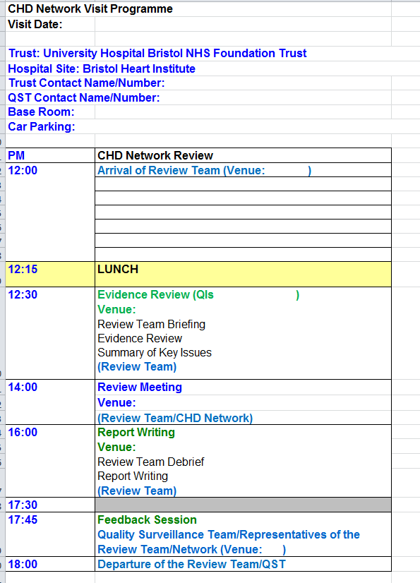
3 Day Structure
Day 1: South Wales and South West CHD network
Day 2: UH Bristol –visit to paed and adult services, level 3 reps
Day 3: UH Wales – visit to e paed and adult services.
Output:
Initials findings report/feedback session
Formal report

Slide 4
Preparation
Peer Review Training- 2nd April 2018, 13.00-16.30, Bristol
Briefing on peer review
Training to be a reviewer – application form and FAQ
NHS Circular- key deliverables
1. Current status against deliverables
3. Evidence Folder- 2 weeks before peer review

Slide 5
Thank you and Questions

