Slide 1
Service Delivery Group – January 2019
Psychology Team Update – Dr Vanessa Garratt, Paediatric and ACHD Cardiology Psychology Lead

Slide 2
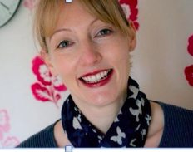
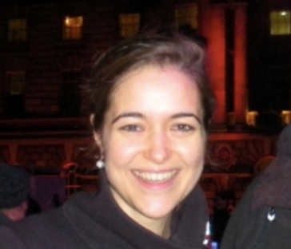
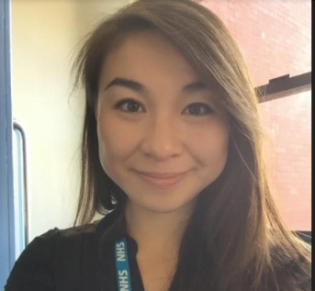
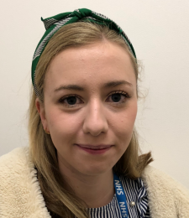
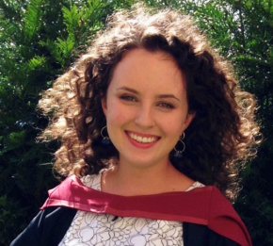
The Service
0.2 wte 2005 – 2015
2017 onwards
3.4 wte in Bristol
Covering the following pathways for all families in the network:
Fetal
Catheter
Surgical
ACHD
General outpatients

Slide 3
The proposed approach (July 2017)
Establishing a tiered approach to psychological support
Patients to find the support they need when they have questions or concerns
Clinicians to direct patients to appropriate care and support when needed
Equitable access to specialist care across the network to those in greatest need
Notes:
Templates – with all relevant standards (adults paeds L1-L3)

Slide 4
Developing the model
Resources for all clinicians and families (32 toolkits, support digibook, 9 visual pathways)
Embedding psychology in existing clinics, teaching training and consultation
Targeted 1:1 Support

Slide 5
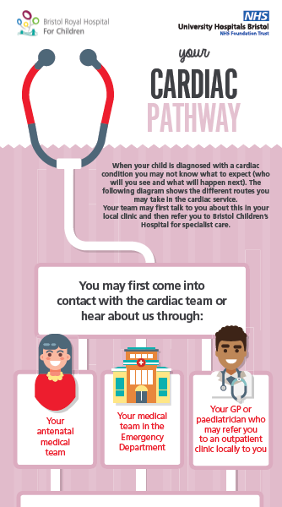
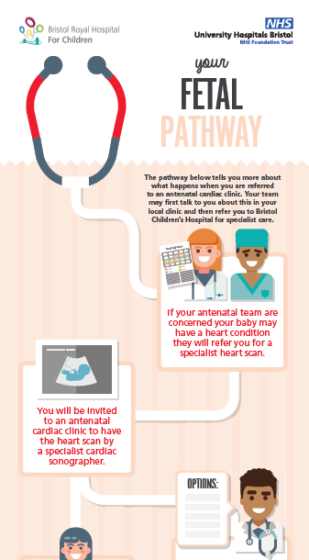
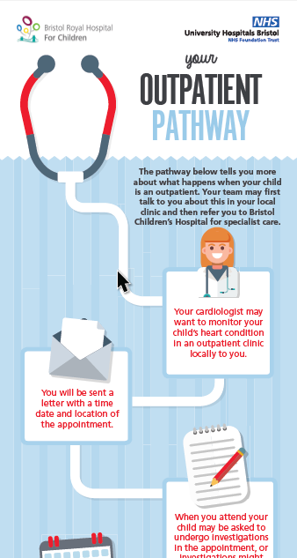
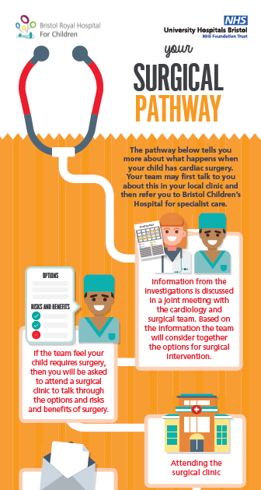

Slide 6
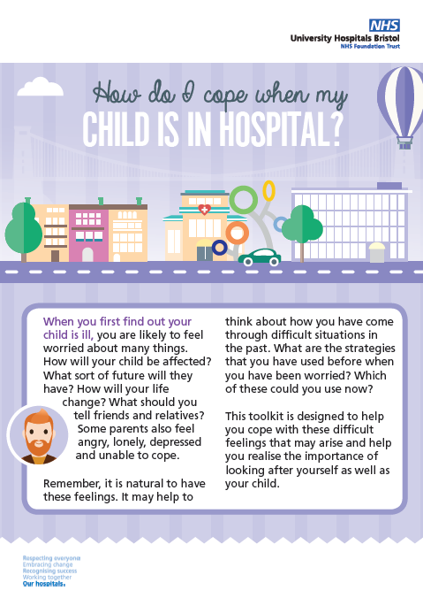
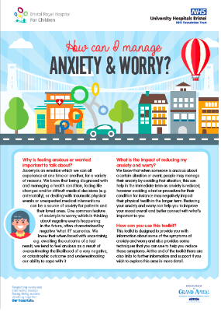
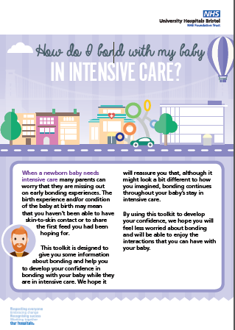

Slide 7
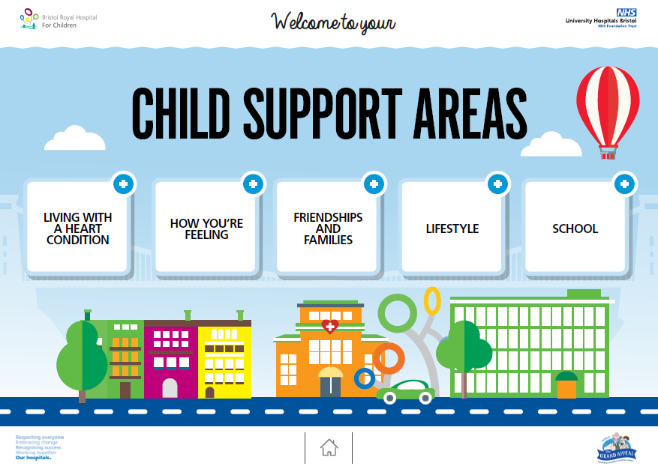
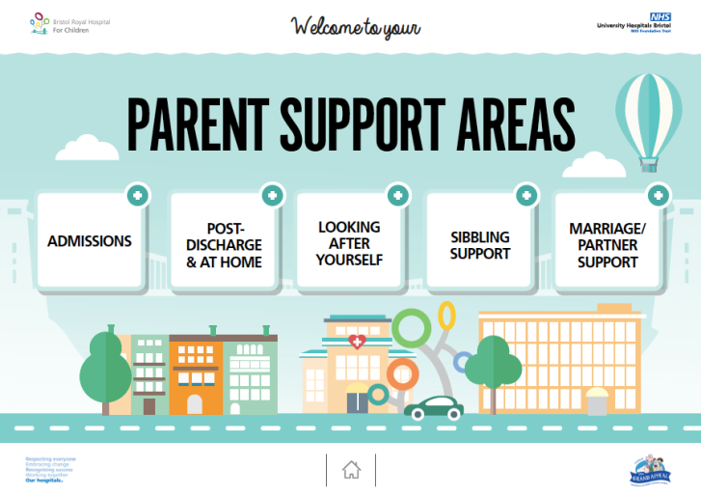
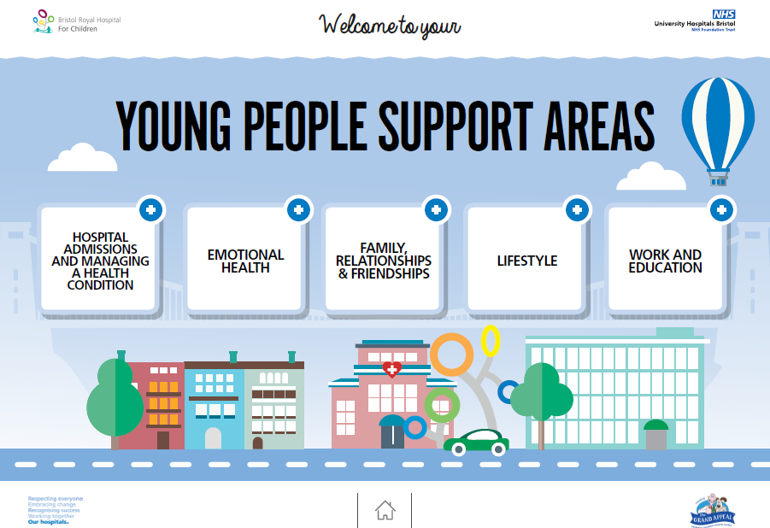
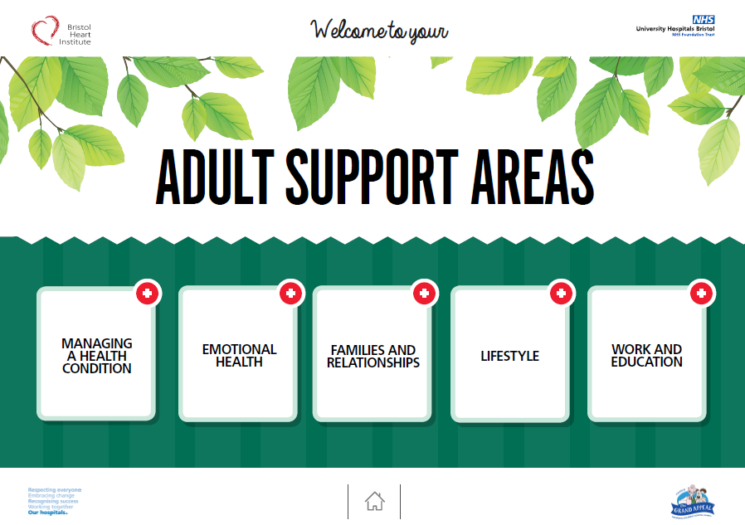
Notes:
Lots of ideas on how to improve…
Email/electronically/automatically

Slide 8
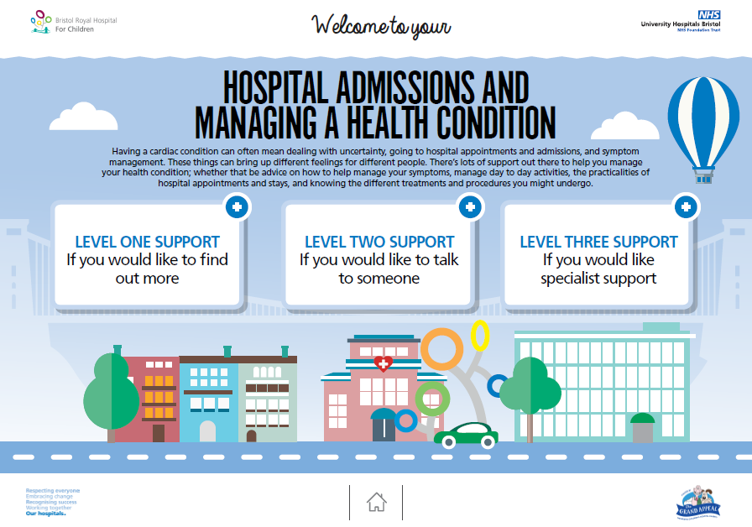
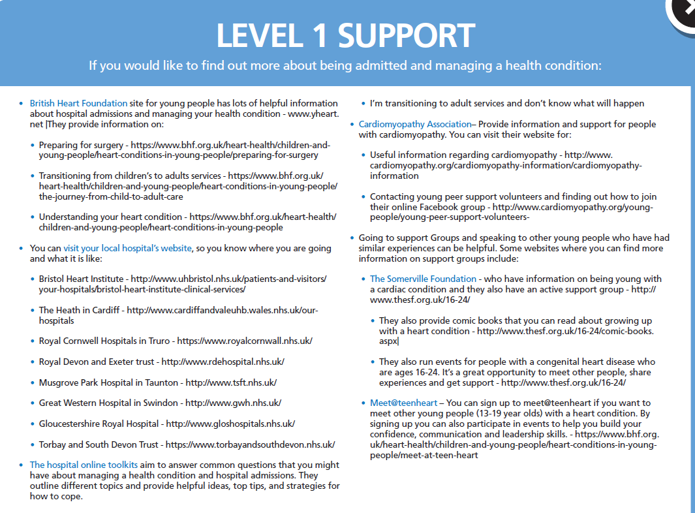
Notes:
Lots of ideas on how to improve…
Email/electronically/automatically

Slide 9
Surgical pathway
Putting psychologists into existing clinics, is this a better model?
Medical and psychological collaboration
More families seen
Time effective
Preventative
Reduces referral time
Reduces travel time
Surgical pathway
Surgical clinic
Clinical Psychology consultation
Targeted support if required (face to face, telephone, virtual)
Inpatient support
Follow up support if required
Pre admission clinic
Clinical psychology and CNS consultation

Slide 10
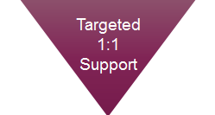
What do we offer in 2018?
10 outpatient clinics offered a week with 28 appointment slots in total
8 inpatient clinics with 12 appointment slots in total
Face to face
Telephone
Virtual clinic
Pathway | Outpatient Face to Face | Outpatient Telephone | Inpatient
Fetal | 1 clinic ( 3 slots) | 1 clinic (3 slots) | 1 clinic (2 slots)
Catheter | 1 clinic ( 3 slots) | 1 clinic (3 slots) | 1 clinic (2 slots)
Surgical | 1 clinic (3 slots) | 1 clinic ( 2 slots) | 2 clinics (4 slots)
ACHD | 3 clinics (11 slots) | 2 clinics (4 slots) | 4 slots

Slide 11
Referral Criteria
Difficulty in coping with or adjusting to health condition/status e.g. further cardiac surgery required, poor prognosis, long hospital admission life limiting illness, significant impact on day to day functioning
Distress related to a long hospital admission for their cardiac condition
Distress associated with physical issues such as scars and symptoms such as pain, cyanosis, breathlessness, and tiredness.
Trauma associated with past medical interventions(e.g. MRI, CT scan, ICD implantation, Catheter implantation, Cardiac surgery) and hospital and needle phobia.
Anxiety related to a high risk pregnancy
Anxiety related to upcoming medical procedures
Additional needs (including learning disabilities) requiring additional support when accessing treatment

Slide 12
How to refer?
Year One
Via cardiac nurse specialist teams
Level one centre cardiologist
Vis electronic referral system
Year Two – raise awareness of how to refer

Slide 13
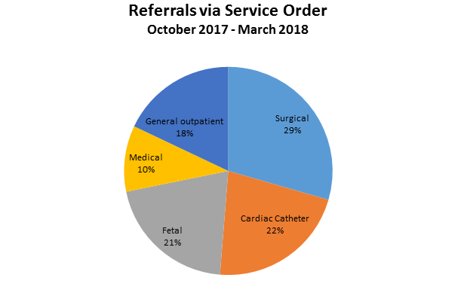
1:1 support – Paeds data
Pathway | No of referrals
Surgical | 23
Catheter | 17
Fetal | 16
Medical | 8
General outpatient | 14
Total | 78

Slide 14
Offering telephone clinics
Summary telephone appointments (6 MONTHS)
68 people referred ( ⅓ inpatients, ⅓ outpatients face-to-face, ⅓ outpatients telephone)
Outpatients who live outside of BristoL
86% preferred telephone appointments
14% declined telephone appointments, opting for local face-to-face support
General feedback around telephone appointments
Parents feedback that whilst they would have preferred to see a cardiac clinical psychologist, they opted to see a general clinical psychologist as they can be seen face-to-face
Many parents said they are glad that Psychology can be offered via telephone so that they do not have to travel to Bristol to speak with a clinical psychologist

Slide 15
1:1 support – ACHD
69 referrals since Sept 2017
73% opted in for treatment
89% outpatients -11% inpatients
63% female
On average 6 sessions

Slide 16
Our Dilemmas
How to raise awareness of the resources so families, adults and clinicians can access initial information and signposting?
How to ensure we continue to monitor and review when we integrate psychologists into clinics and when we offer
How to assess whether offering telephone and virtual clinics is a ‘good enough’ service to the network?

Slide 17
2019 – Our Plan
Raise awareness of resources so families, adults and clinicians can access initial information and signposting?
Engage level 3 centres in referring to the service
Assess whether offering telephone and virtual clinics is a ‘good enough’ service to the network?
Hold psychology network event to support clinicians
delivering psychology across the network

