Slide 1
Patient representatives Recruitment and Involvement Sheena Vernon

Slide 2
Purpose of session
Standards/Background
Our patient engagement objectives & challenges
Stakeholder day- what our patient reps said?
Plan for recruitment
Plan for involvement
Support for patient reps

Slide 3
Background
Notes:
Standards in 2016 outlined to role of the patient rep very briefly.
We would hope for a wider level of patient engagement on a number of levels

Slide 4
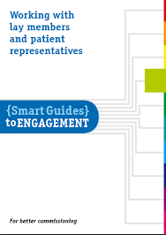
National documents

Slide 5
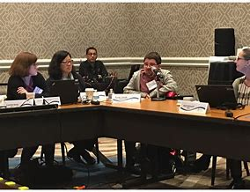
Successful patient engagement- our objectives
Clear Trust process, recruitment
Trust governance
Board participation
Communication
A balanced group, young people, male, female

Slide 6
Challenges
Meaningful engagement eg Board representation
Duration of involvement
Unclear remit
Other commitments

Slide 7
Stakeholder day July ;18 - What our patient reps said?
We want to work together as partners in the network
An investment in patients as leaders
A good governance process to recruit, support and grow patient partners at board level
Develop the use of social media as a tool for involvement without losing the emotional connect of face to face work
Disseminate knowledge, debate and discuss
Be engaged in the conversation
Get the simple things right and be aware that patient partners have other lives
Be able to say – ‘this wouldn’t have happened if it were not for patient partners’
Workshop feedback Tony Watkin

Slide 8
Plan for recruitment
Increasing no. of patient representatives
Following up on expressions of interest
Invite letters to existing patient representatives for Independent Cardiac Review
CNS approaching patients
Working with BRHC Youth Worker
Advertising in CHD newsletter and CHD website
2. Supporting documentation
Patient Representative Job Description
Contract
Code of conduct
Expenses form
Application form
3. Training for patient reps
Other suggestions?

Slide 9
Plan for involvement- menu of options
Level | Description | Examples
Level 1 | Attend meetings | Eg. Network Board, Service Delivery Group – for specific groups
Level 2 | Review relevant content from network meetings and network public documents | Eg. Patient information leaflets, CHD network website, discharge comms.
Level 3 | Participate in the CHD Patient Rep Virtual Group | Patient Rep peer support, keeping patient reps informed, review documents, ideas, events. Participate in audits and surveys. Support engagement events. Involvement in relevant projects. Use of social media to communicate about network
Patient Rep events- quarterly

Slide 10
Support for patient reps
Meeting twice a year (1st May, between board)
WhatsApp
Psychologist support
Supervision meeting – for personal support
Training from Trust
How to present at the board
Supporting carers

Slide 11
Thank you

