Slide 1
Improving Discharge Communications Catherine Armstrong, Consultant Paediatric Cardiologist

Slide 2
Background

Slide 3
The CHD Network South Wales and South West
Level 1 Centre – UH Bristol for Paeds and Adults
Level 2 Centre – UH of Wales (Cardiff) – interventional cardiology
for paeds and adults
Level 3 Centres
South West: Royal Cornwall – Truro, Musgrove Park – Taunton, N Devon – Barnstable, S Devon – Torbay, Royal Devon & Exeter, Cheltenham & Gloucester, Bath, Plymouth
South Wales: ABMU Health Board (HB) – Singleton, Morriston, Princess of Wales; Aneurin Bevan HB – Royal Gwent, Nevill Hall; Cwm Taf HB – Royal Glamorgan, Prince Charles; Hywel Da HB – Glangwili, Withybush.
Notes:
SV

Slide 4
Background to this work
Discharge communications – known issue?
Concern raised through network board from Level 3 Consultants
Survey undertaken with consultants around region to quantify
Initial work scoping improvement, but….
Notes:
AJT

Slide 5
Survey Results

Slide 6
Survey
Undertaken end of 2017
11 responses from around the region:
GWH x 2 , POW, Cardiff, Royal Glamorgan, Royal Cornwall, RDE, Taunton, Torbay, Glangwili, Bristol
Adults 27%, Paediatrics 73%
Notes:
SV

Slide 7
Three key issues – 1. Timeliness
65% said they do not consistently receive discharge summaries in a timely fashion from the Level 1 Centre:
Whilst quality from surgeons and ward 32 are good they are often too slow in turnaround…. This becomes an issue when early 2 week scans are expected.
Letters may arrive too late to organize local follow-up in a timely manner
The main problem is when pt rings up asking why they have not received appt for review/echo and we dont even know they've had the procedure - in the are case of discharge summary getting through there will often be 'needs follow up in DGH with echo in 2 weeks' and arrives at 10 days post discharge giving us no time.
Notes:
SV

Slide 8
Three key issues – 2. Quality/ Content
Over 40% of respondents rated the quality of discharge summaries as average or poor
Patients also unsure they’re getting adequate information at discharge
Often there is limited information about co-morbidities. Tends to be a list of results/echo reports, without interpretation/prognosis/plans don't forget that the receiving doctor is not usually a cardiologist and we need to be able to understand the implications of findings.
..often lacking in key information (e.g. indication and desired duration of out-of-the ordinary medications, i.e. those other than diuretics)
PICU summaries are excellent but often do not have necessary cardiac information
NICU summaries are often not sent.
Notes:
SV

Slide 9
Three key issues – 3. Appropriate recipient(s)
As I say it is a problem to do with the way the discharge summary computer entry does not allow the Level 1 team to automatically send copy to Level 3. The same applies to JCC outcomes and letters from clinics- if automatically copied (rather than someone having to remember each time ) then we'd be fine
They are often …addressed to the wrong PEC
Reports go to referring consultant cardiologist at Level1 centre to GP pt ...but not to referring consultant in DGH/level 3.
Don’t go to the right consultants
Notes:
SV

Slide 10
IM&T Context

Slide 11
IM&T Context
National TOC Communications
New standards for ‘documents’ and electronic messaging
Involvement of PRSB and AoRMC on content
Introduction of structured messaging for electronic communications
Moving all TOC Comms to Medway
Discharge summaries progressively with EPMA or separately as with ICE
Clinic letters changes in current BigHand, progressive transfer to Medway Noting
SNOMED CT
What does this mean for the way we record information?
What if I simply want to record narrative?
Notes:
SV

Slide 12
Improvement ideas from the survey & subsequent work
Issue | Potential solutions?
1. Timeliness: | Could Heartsuite be adapted so info could be uploaded straight to email? Could Dolphin Ward move to ICE (or now Medway?) discharge summaries in line with rest of hospital? Could the CNS admin support person backfill the ward clerk function when she is not in work? Could we agree a rule that any requests for action >4weeks must not be sent by post but must be communicated another way (ie telephone, email)
2. Quality/ content: | Letters signed off by on-service Consultant Could we move to nurse-led discharge in BRHC? (This happens already in adults) Better guidance/training for juniors Streamline the amount of information required to make the template easier to complete
Notes:
SV

Slide 13
Improvement ideas from the survey & subsequent work
Issue | Potential solutions?
3. Appropriate recipient(s): | Heartsuite has a discharge summary template. Idea is that these details are checked at pre-admission or on ward – details are updated if incorrect. Whose responsibility would this be? Could each centre have a single email address or small group of individuals responsible for receiving and forwarding on to the relevant clinician? CHD Website to have details of all network clinicians. This would need to be kept fully up to date e.g. full review every 6 months. On ICE, there is no current box/prompt to say where else the information needs to be sent – this would be useful. If the DS was sent to Consultant’s secretaries, he/she could be responsible for ensuring it was sent out to the region appropriately,
Notes:
SV

Slide 14
Task and Finish Group: Session 1
23rd October 2018

Slide 15
Task & Finish Group - Session 1
Agenda
Review issue and work thus far
Map the current process
Define our vision – what would good look like?
Make our high level plan
Agree our next steps
Attendees
- Insert roles
Notes:
SV

Slide 16
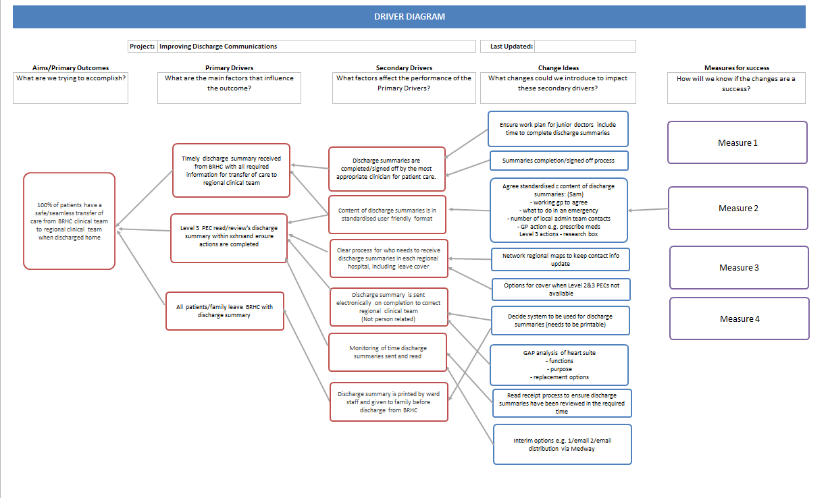

Slide 17
Next Steps
2nd Workshop provisionally booked 21st Feb
Agreed future state
Work plan to achieve future state
Just do its
Medium/long term actions
Report back to SDG at next meeting

Slide 18
Thank you & Questions

