Slide 1
Network Governance
Service Delivery Group, January 2018
Cat McElvaney, Interim CHD Network Manager

Slide 2
Items Arising
The Network Board Structure
Service Delivery Group- roles and responsibilities
Chairperson of the group
Reporting to the Network Board (next meeting 21st May)
Notes:
Templates – with all relevant standards (adults paeds L1-L3)

Slide 3
The Previous Network Board Structure- a recap
Strengths | Weaknesses
Good representative of stakeholders | Infrequent for core team
Good general engagement | Lack of time for detail/can feel rushed
Broad range of topics covered | Limited opportunity for members to contribute
Making progress | Some inconsistency of membership
 | Range of issues covered too broad
 | Lack of accountability?
Opportunities | Threats
To break functions into smaller groups able to get into detail | Issues may fall through gaps
To have focused task and finish groups for defined short term projects | The groups don’t interface properly
To use members’ expertise & interests more | May have inconsistent membership
Better rhythm of meetings for Network team
Greater accountability
Notes:
Templates – with all relevant standards (adults paeds L1-L3)

Slide 4
Agreed Network Board Structure
Network Board
Network Clinical Governance Group
Task & Finish Groups
Network Service Delivery Group
Notes:
Templates – with all relevant standards (adults paeds L1-L3)

Slide 5
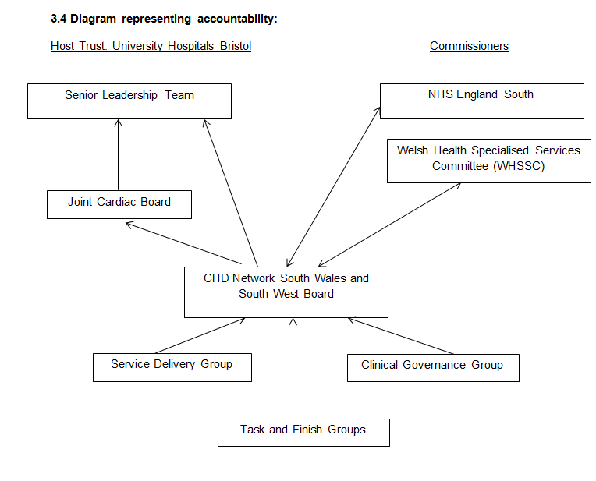
Network Governance

Slide 6
Remit of each group
Network Board | Network Clinical Governance Group | Network Service Delivery Group | Task & Finish Groups
Overall responsibility | Education and training programme | Standards & self-assessments | Specific tasks or projects
Escalation of concerns | Incident management and learning | Performance and capacity | Defined lifespan
Risks | Annual M&M | Workforce issues | For example:
Strategic direction | Audit programme | The website and other technology projects | Paediatric protocols group?
Performance assurance | Clinical pathways, protocols, guidance | Patient engagement and support groups | Discharge communications reference group?
Centres’, commissioners, charity etc. updates | Patient leaflets and pathways | Finance/Tariffs etc
Notes:
Templates – with all relevant standards (adults paeds L1-L3)

Slide 7
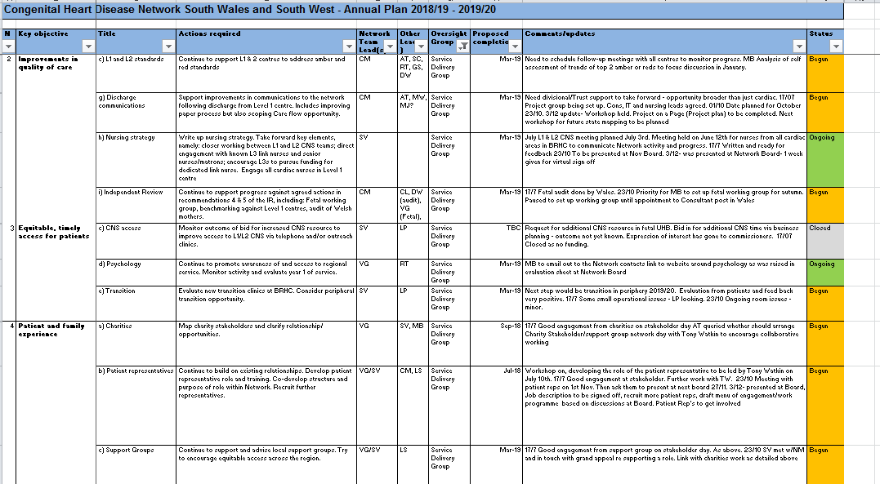
Service Delivery Group – roles and responsibilities
Delivery of work plan for SDG;
Supporting Centres within the network to understand and seek adequate funding for their services
Supporting Centres to address gaps in standards
Delivery of service improvement projects
Delivery of the nursing strategy
Undertaking actions required of the network by commissioners or reviews
Promoting and evaluating any new network services
Notes:
Templates – with all relevant standards (adults paeds L1-L3)

Slide 8
Service Delivery Group – roles and responsibilities cont’d
Delivering improvements to transition care
Identifying and addressing workforce issues within the network
Ensuring appropriate communications with network stakeholders
Responsibility for the network website
Developing the role of patient representatives within the network and supporting the patient engagement agenda
Developing relationships with charities and support groups

Slide 9
Membership of the Service Delivery Group
Have we got the right people in the room?
Level 1- Doctor and Nurse, Adult and Paediatric
Level 2- Doctor and Nurse, Adult and Paediatric
Level 3- Doctor and Nurse
Psychology
Adult services manager- Level 1 and Level 2
Children services manager- Level 1 and Level 2
AHP Lead- Physiologist/Pharmacist/Physiotherapist?
Patient Rep
Notes:
Still outstanding
No adult level 1 doctor
No Level 2 Dr
No adult manager- level 1

Slide 10
Service Delivery Group – Chairperson & Reporting
Chairperson for the group
Bi-annual progress report to Network Board
Progress to date/key achievements against work plan
Plan for next 6 months
Issues/Risks to escalate

Slide 11
Thank you & Questions

