Slide 1

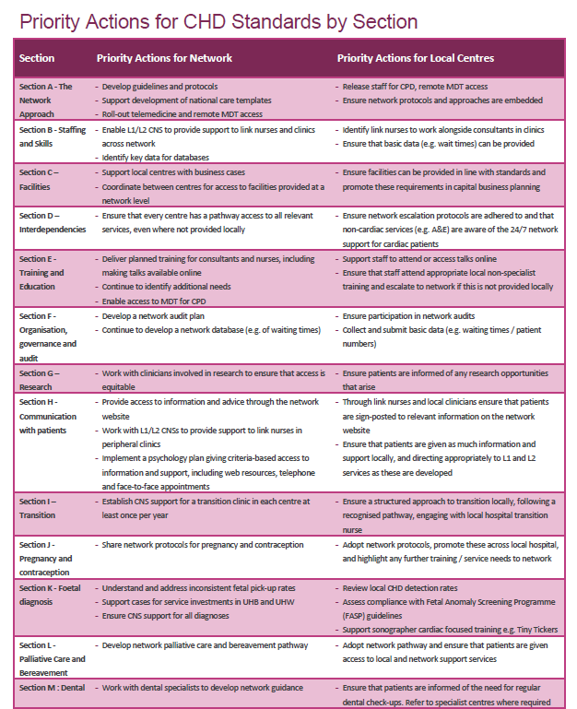
Annual Report
Notes:
Feedback? Have people red it, is it what people expected
Expectations moving forward.

Slide 2
Network Board – September 2017
Network Team Update

Slide 3
Self-assessments and visits
Self-assessment
Templates sent out
Trusts RAG rated
Data reviewed
Key areas of concern: transition, nursing, image sharing, psychology
Visits to Trusts
Action points agreed
Some RAG ratings adjusted
Notes:
Templates – with all relevant standards (adults paeds L1-L3)

Slide 4

The Standards
Section A: The network approach
Section B: Staffing and skills
Section C: Facilities
Section D: Interdependencies
Section E: Training and education
Section F: Organisation, governance and audit
Section G: Research
Section H: Communication with patients
Section I: Transition
Section J: Pregnancy and contraception
Section K: Foetal diagnosis
Section L: Palliative care and bereavement
Notes:
12 sections
300 pages of advice
Paediatric and adult

Slide 5
The Standards
Notes:
12 sections
300 pages of advice
Paediatric and adult

Slide 6
The Standards
Notes:
12 sections
300 pages of advice
Paediatric and adult

Slide 7
Self-assessments and visits
 | No of centres | No of responses | Overall % of green | Overall % of green – post visit
Adults | 12 | 11 | 68% | 73%
Paediatrics | 14 | 13 | 64% | 69%
A solid starting point
5% increase on number of standards rated green
Largely due to:
  moderation of responses following meeting with the Network team
  adoption of Level 1 centre protocols within Trusts

Slide 8
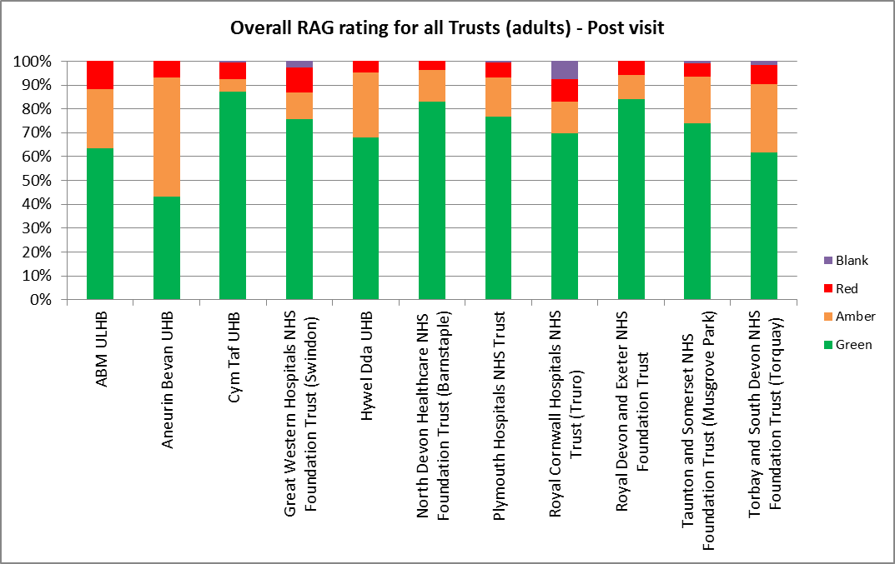
RAG ratings by Trust – Adults Services

Slide 9
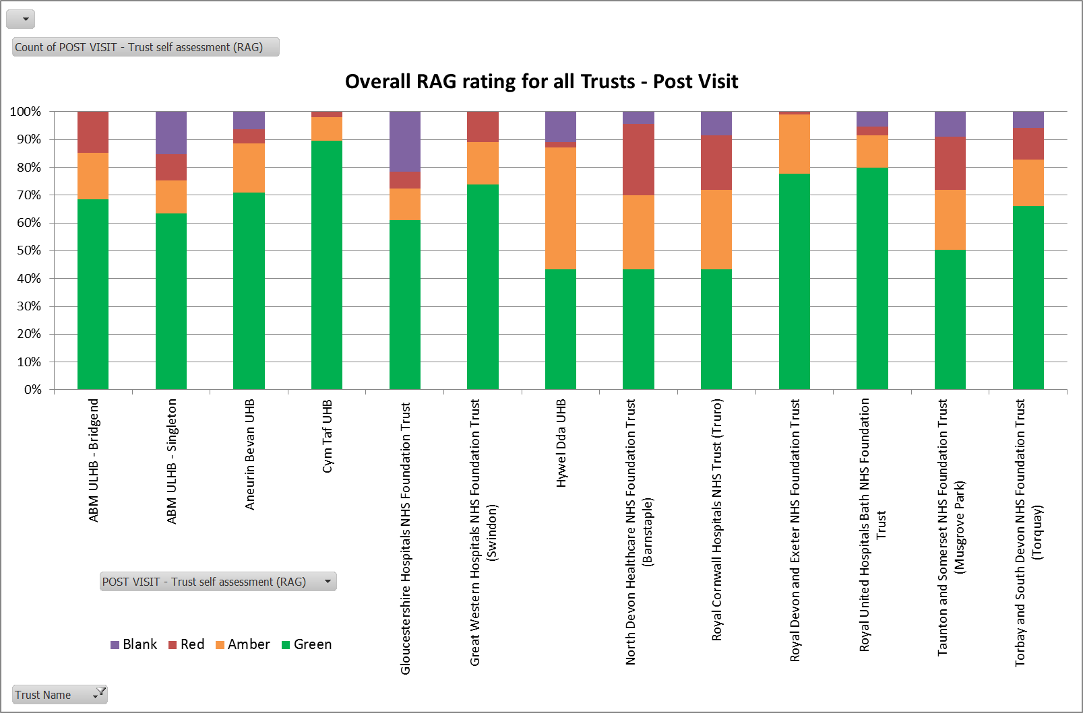
RAG ratings by Trust – Paediatric Services

Slide 10
Self-assessments and visits
Next steps:
Review the Network level changes (access to psychology, pregnancy protocols, improvements to PACs and video conference enabling access to MDTs)
Will improve green ratings
What feedback would Centres like from the Network team after the visits?
Our suggestion: short document
  Current situation
  Network solutions
  Local solutions
  Other solutions

Slide 11
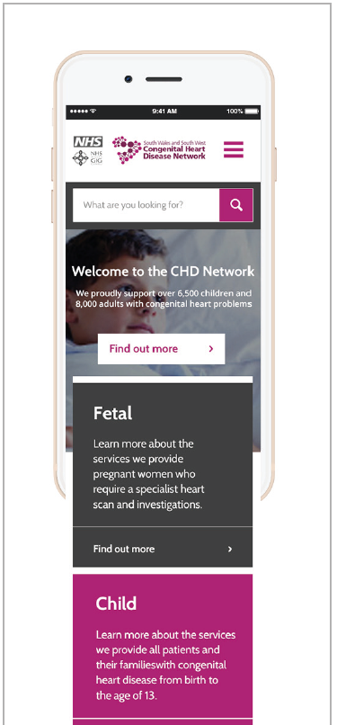
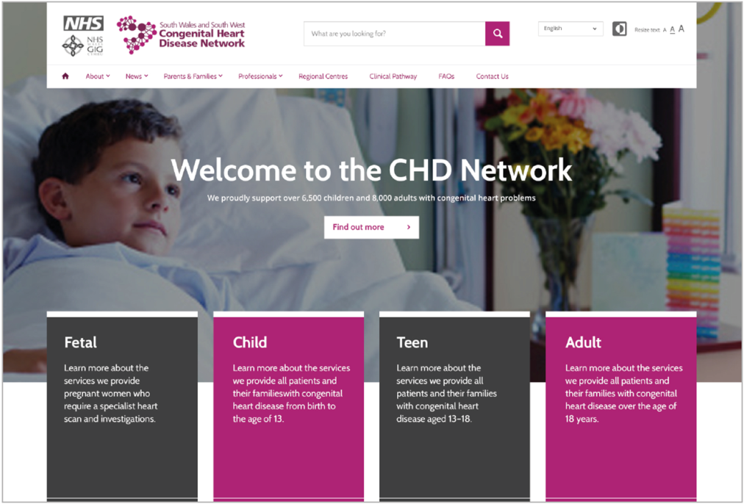
Website
  Slow progress from selection of supplier to contract finalisation
  Delayed start to build – disappointing!
  Collation of information is ongoing
  Escalation to Executive Director level at UHB
  Contract with team for sign off as of 25/09

Slide 12
Board Meeting Feedback
You said | We have
Useful to add fetal and pyschology | Invited fetal rep. Psychology attended in June and planned for December.
More L2/L3 focus | Sections added to agenda.
Could do with patient story | To be actioned.
Mid morning break | Added to agenda.
More clarity requested for patient reps | To be actioned.
Need to measure action at a local level | For discussion.

Slide 13


Network Risks
  Four risks on Network risk register
  Taunton does not have a PEC in post
  Medical workforce retirements/gaps and lack of succession plans
  Core Network Team funding source in long term
  Lack of dedicated nursing resource around region
  In depth-discussion as part of Governance afternoon today

Slide 14



Patient Engagement
Network Engagement
Newsletter circulation
OPD clinic visits completed
Pt engagement Cardiff, Autumn
Heart Families South West meeting
Web site (Facebook)
Virtual ref group
Adult Young People group
Notes:
Challenges to circulate the Newsletter
Opd visits completed
Cardiff awaiting a date
Heart families South West meeting 12th October
Web site to provide information and also to provide a forum for Patients and Families to ask questions and make suggestions
A Virtual reference exists in Paeds but not in Adults.
Looking at gathering Yps on a data base to enable us to get feed back from Yps, gather opinion and also monitor lost to follow up

Slide 15
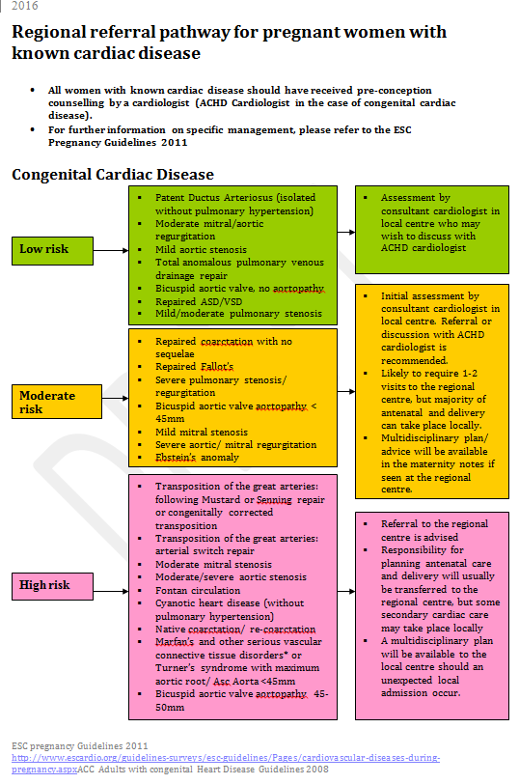
Clinical Updates
Aortopathy in pregnancy
Regional referral pathway for pregnant women with cardiac disease
Anticoagulation strategies for women with mechanical heart valves in pregnancy
Complex EP cases in pregnancy
Protocols, medication and arrhythmias….
Notes:
Pregnancy protocols, adopted in Wales

Slide 16
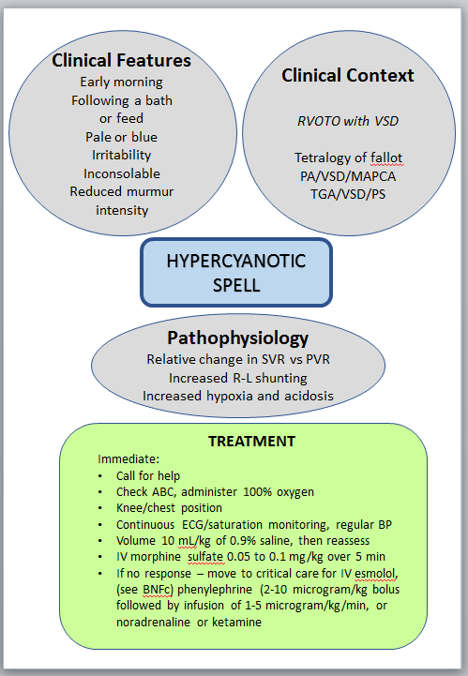
Protocols
Protocols, medication and arrhythmias….
Heart failure
Cardiology interventions
Dirk Wilson
Notes:
Information also on DMS

Slide 17
National update
  Consultation now closed
  Decisions awaited at NHS Board level September 2016
  CRG meeting October
  NHS England May

Slide 18

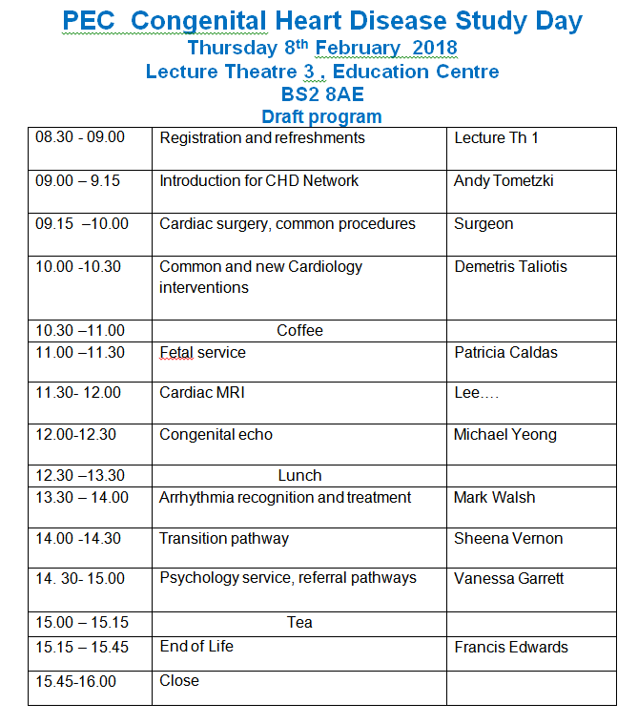
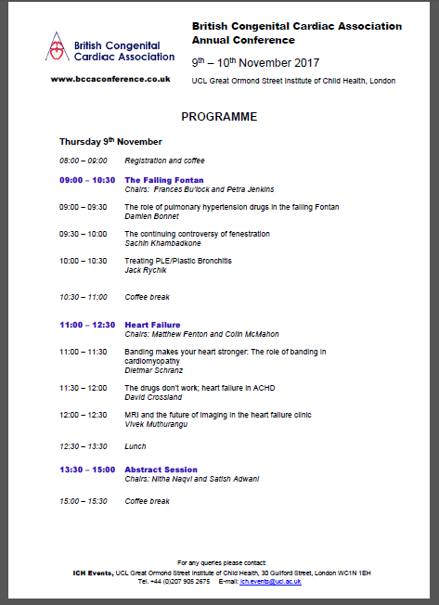
Education & Training – Upcoming Dates

Slide 19
Network M&M and Governance

Slide 20

Network Risk Register
What is a risk?
An uncertain event or set of events that, should it occur, will have an effect on the achievement of objectives of a programme area (critical success factors).
How is risk measured?
In terms of likelihood and consequence
1 | 2 | 3 | 4 | 5
Rare | Unlikely | Possible | Likely | Almost certain
This will probably never happen/recur | Do not expect it to happen/recur but it is possible it may do so | Might happen or recur occasionally | Will probably happen/recur but it is not a persisting issue | Will undoubtedly happen/recur, possibly frequently

Slide 21
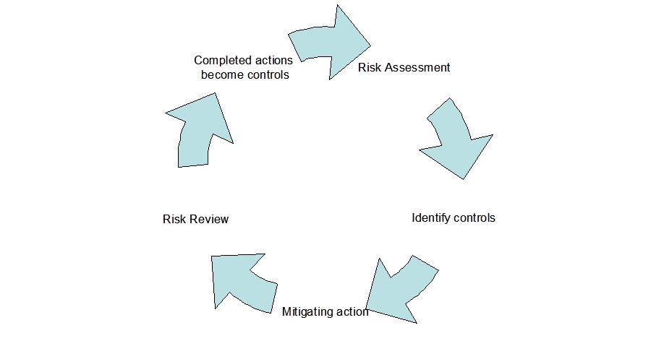
Network Risk Register
Likelihood of Impact:
  You should be driven by actual evidence of occurrence, ideally incident reporting.
Actions and Controls:
  A control is something that is already in place and is actively mitigating the risk;
  An action is something you intend to do in the future to mitigate the risk. It might be a one off and when complete will reduce the risk, or be ongoing and thus become a control.

Slide 22
Network Risk Register
Risk description | Risk ID | Rating | Lead | Actions | Mitigations
Taunton paediatric service does not currently have a PEC. Capacity insufficient at present to meet demand so backlog growing. Risk of patient harm whilst waiting. Risk that Taunton may cease to provide this service. | 2214 | 16 (possible x major) | AF | Paper being taken forward in Taunton to establish options | SLA with Exeter Visiting Bristol Consultant Waiting list being reviewed for priority
Risk of long-term viability of ACHD Service due to lack of medical workforce succession plans | 2191 | 8 (Unlikelyx major) | AT | Survey of medical workforce to quantify issue undertaken by Network team* | Local teams are raising the issue in Centres, being supported by Network team

Slide 23
Network Risk Register
Risk description | Risk ID | Rating | Lead | Actions | Mitigations
Risk that Trust cannot secure funding from commissioners for the CHD Network | 1824 | 3 (Possible x Rare) | VF | Continue negotiations with commissioners re future funding. | Case submitted to commissioners in 2016. Continuing discussions with NHSE. Trust has agreed to fund the Network team for 2017/18.
Risk that Network centres will be unable to identify or fund link nurses, reducing quality of service to patients | 2204 | 8 (Minor x likely) | SV | Options being explored with local teams. Link nurse development programme in place. | Plans to increase access to L1&2 centre nurses for high need patients.

Slide 24
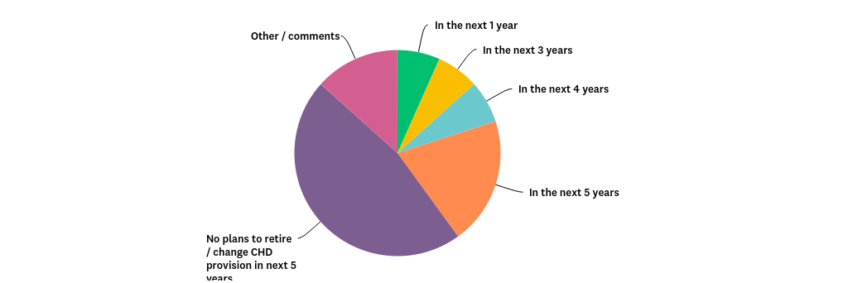
Risk 2219: Medical workforce across the Network and Succession Planning
Survey key results:
15 respondents - 60% paediatrics, 20% adults, 20% both (54 Consultants in Network)
76% of respondents felt that provision of time allocated to CHD in job plans was inadequate to meet service demand
Over half of respondents had plans to retire or reduce NHS time in the next 5 years

Slide 25
Risk 2219: Medical workforce across the Network and Succession Planning
Survey key results:
8 responses regarding whether any succession plans have been started.
  Only 1 had a succession plan, for which Trust management support was not yet confirmed. 1 expected trainee to return to the Unit as Consultant.
  50% of respondents found the letter from the Network regarding CHD sessions in job plans useful in negotiating job plan, although some respondents noted they had no knowledge of the letter being sent or received, or it was not used as part of appraisal/job planning process.

Slide 26
Risk 2219: Medical workforce across the Network and Succession Planning
For discussion:
Where do we go from here with this issue?
What support could the Network offer?

Slide 27
Network incidents
No. | Description | Site(s) | Action | Lessons Learned?
44166 | Circulatory failure soon after Fontan surgery due to thrombus – discussions about timeliness of acceptance into the surgical centre (Bristol) and the response to the problem | Cardiff and Bristol | Investigation being undertaken | TBC
44162 | A 15 day old baby was treated for SVT in Royal Gwent and was stable for a few hours. The baby then deteriorated in the night, needed intubation and had difficult resuscitation, transferred by Watch team to Cardiff PICU and later care was withdrawn. | Cardiff and Newport | Investigation being undertaken | TBC

Slide 28
Network incidents
No. | Description | Site(s) | Action | Lessons Learned?
42765 | Transposition of great arteries that was diagnosed postnatally. No harm to patient as the diagnosis was early and the child was well. Surgery done in a weeks time and the child is doing well. | Swindon | Case reviewed by Swindon antenatal team. | Anomaly checks were not completed as high BMI limited view. This is the correct process as per FASP guidance, the lack of assessment of the outflow tracts was documented and the patient should have been informed that the anomaly was incomplete and why.

Slide 29
NICOR update

Slide 30
Improving Fetal Diagnosis

Slide 31
Improving Fetal Diagnosis

Slide 32
Improving Fetal Diagnosis

