Slide 1
Video Conferencing within the Network – all IP over N3 vs older ISDN
Scenarios
  HD VC specific hardware static v mobile
    Attend JCC remotely – Level 6 room IP 10.160.144.10
    Attend teaching – Level 6 room IP 10.160.144.10
    Urgent discussions
      Cardiology – Consultant office IP 10.160.144.11 (Tometzki Office)
      PICU – PICU seminar room IP 10.160.144.12
    Welsh Network – PEC teaching ? Possible access from South West
  Joint Consultations – HD VC specific hardware static v mobile
    Fetal – Exeter & Truro (mobile and fixed options)
    Paediatric – Exeter, Torbay, Truro & Plymouth
  Direct Consultations – PC based via Cisco Jabber to smart phones/tablets
    Psychology
    CNS teams
    Consultants – e.g. consent

Slide 2
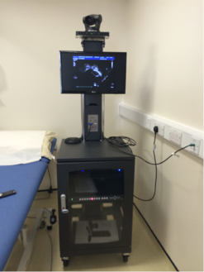

Information gathering to move forward
People
  Clinical Champion; Name, email, mobile/ext
  IT Champion; Name, email, mobile/ext
Currently available equipment in your unit
  Make and model
  Location including fixed or mobile
  Connectivity – ISDN (telephone line) or Broadband (N3)
  If N3 what is the IP address?
Wish list
  Identify need – JCC/MDT
  Mobile vs static vs hybrid
  Ability to share Paed & ACHD
  Connectivity to PACS via PC and/or direct ultrasound machines
  Recording sessions
Funding
  Legacy fund for South West Implementation
  Individual unit vs whole network approach (pros – better deal, cons procurement made be simply too complex)

Slide 3

Palliative care….. Is a positive option.
Palliative care starts at diagnosis and not to the
very end of life
Improves quality of life by focusing on living well
with deteriorating health
All professionals need to incorporate holistic
palliative care into their practice
An understanding of typical, multidimensional illness trajectories can help professionals know what to offer and when
Palliative care is about a philosophy of care and not a location of care
Palliative care is everyone’s business working with patients and families

Slide 4

Paediatric Intensive Care – Bristol
Serving a population of 900,000+ children
17 commissioned beds, 18 in winter
Tertiary service for all S West sub specialties and supra-regional critical care to CHD patients from S Wales
Bed occupancy is an issue – at least 75%, but over 80-90% not uncommon
In 2016, >10% of elective cardiac surgical cases were unable to be accommodated
Staffing issues (vacancies/mat leave/sickness)
WATCH success
National review in England of Paediatric Intensive Care
Development plans proposed – aim to reduce cancellation rates & improve environment

Slide 5
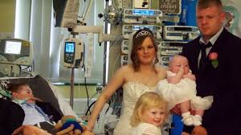
Paediatric Intensive Care – Bristol
Recommendations
Support expansion case
Risk added to risk register
Maintain communications with
PICU team

Slide 6
Psychology Update
In 2017 increased the cardiac psychology workforce increased to include two new posts:
Psychology Lead
New posts
Paeds –surgical pathway
Paeds – fetal and cath
ACHD
Support from Cardiff post
Increases in the workforce enabled the Bristol based team to develop a 3 stage proposal and network plan (presented to board in June 2017)
Proposal:
To establish a tiered approach to psychological and other support services, such that patients can be directed to appropriate support and that specialist care can be provided equitable across the network to those in greatest need at the appropriate point in their pathway

Slide 7
Psychology Update – The 3 stage network plan
Information gathering: understand what support is needed for (stage of pathway, decision points etc.)
Survey completed and will be presented in March.
Develop solution: develop an online directory of resources / signposts to services, broadening knowledge of other avenues for support; identify clear thresholds / referral criteria for accessing specialist support.
The content and design of the digibook is out to consultation with families and will be sent to clinicians in January
Full service: a lifespan service with access options across the network (video link, telephone support etc.); full knowledge of the range of services across the network both for patients and clinicians including preparation for procedures and adjustment to living with a heart condition
This service will be launched in January and a full manual of referral criteria and how to refer will be available.

Slide 8
Network Board – December 2017
Network Team Update

Slide 9

Twitter
@CHDNetworkSWSW
#CHDNetworkBoard
Notes:
Templates – with all relevant standards (adults paeds L1-L3)

Slide 10
Website
Contract signed (finally!)
Project launch meeting held 20th October
Team developing site map and writing content Webbox develop test site
Focus group and email feedback (clinicians and patients/families)
Team upload content to real site Webbox develop real site
Preview………………..
Notes:
Templates – with all relevant standards (adults paeds L1-L3)

Slide 11
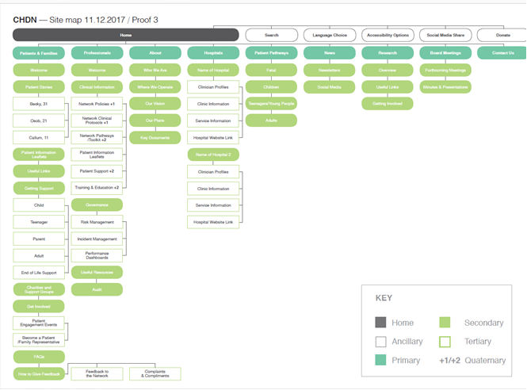
Website
Notes:
http://chdn.webboxdemo.co.uk/admin

Slide 12


Website
Launch!
  Launch via Network email database & twitter
  Work with hospitals’ communications teams: send ‘press release’
    Hospital magazines (‘Voices’),
    social media updates
    hospital websites?
  How do we reach patients?
                >Exact timescale TBC
                >Aim January
Notes:
Templates – with all relevant standards (adults paeds L1-L3)

Slide 13

Audit Programme
Audit requirements
The NHS England Service Specification and Standards 2016 states that Networks should have a Governance Framework in place which includes arrangements for:
Regular continuous clinical audit and quality improvement
Regular audit days including discussion of adverse events and resultant action plans
Regular network meetings of the wider clinical team (including patient representatives) at least every 6 months, for issues such as agreement of protocols, review of audit data and monitoring of performance.
The Congenital Heart Network will:
produce annual audit and governance reports covering ACHD services.
Notes:
Templates – with all relevant standards (adults paeds L1-L3)

Slide 14
Audit Programme
All Centres must:
participate in audits of clinical practice where recognised standards exist or improvements can be made. Participation in a programme of ongoing audit of clinical practice must be documented.
At least one audit of clinical practice (or more if required by NHS commissioners) of demonstrable clinical significance will be undertaken annually.
Audits must take into account or link with similar audits across the network, other networks and other related specialties.
Centres must participate in national programmes for audit and must submit data on all interventions, surgery, electrophysiological procedures and endocarditis to the national congenital database in the National Institute for Cardiovascular Outcomes Research (NICOR); including any emerging data requirements for morbidity audit.
(Section F of the standards)
Notes:
Templates – with all relevant standards (adults paeds L1-L3)

Slide 15
Updated Work Plan
Completed | On track | In progress |  | Not yet started
Inaugural M&M | Strategic engagement | Post-assessment feedback | Charities and support groups | Request ongoing commitment from Trusts
Annual report | Assurance work | Clinical guidelines | Website | Tariff work
 | Risk management | Discharge communications | Medical workforce | Governance Lead
 | Training and education | Nursing strategy & CNS access | Engagement & communications
 | Seeking feedback | Audit programme | Research
 | Financial management | Fetal diagnosis | Funding and finance
 | Addressing major gaps in standards | Image sharing | Escalation
 | Transition | Psychology
 | Palliative Care | Dashboard

Slide 16


Discharge communications
Concern raised at September Board & via exception reports
Survey completed to quantify issue
    11 responses (7 English Centres, 4 Welsh) , thank you
    Only 36% said letters were generally received in timely fashion
    For op notes, this reduced to 18%
    Quality of letters – 63% Good or Very good
    Quality of op notes , this increased to 82%
Notes:
Ask how many people want the op notes?
Or would a summary of the op on the discharge summary, if it was of adequate detail, suffice?

Slide 17

Discharge communications
Notes:
Lots of ideas on how to improve…
Email/electronically/automatically

Slide 18

Discharge communications
Series of meetings at Level 1 Centre (BHI and BRHC)
  Ward clerk, consultants, IT, Nurses, Data Manager…
Can of worms opened!
  Different opinions across Level 1 teams
  IT barriers
But – agreement it’s an important area to improve
Primary focus is discharge summaries
Options to improve process under development
Aim for improvements in 2018
  Electronic solution
  Standard Operating Process

Slide 19
Discharge communications
How to manage receipt of clinical letters at Centres, if an electronic solution is possible?
  One generic email address actioned at Centre?
  Sent to individual clinician contact details on website, and secretary?
    Website still missing large number of clinician profiles (!)
    What if individuals are on leave?
  Send to all consultants (and secretaries) at a Centre?
  Other?

Slide 20

Medical Workforce Concerns
Survey of concerns undertaken by JD
Results and discussion at September Board
Formal letter written highlighting our concern, raising the profile of the issue and seeking help
Contact made with:
  Health Education England
  Royal College of Paediatricians
  Special Advisory Committee
  Deanery
  British Heart Foundation

Slide 21
Medical Workforce Concerns
Small Medical Specialty Review 2016 – Paediatric Cardiology. No change in current training commissions. This should meet workforce requirements. Reviewed bi-annually.
Key contacts made at Health Education England – Sanjiv Ahluwalia, Lead Dean for Cardiology and General Paediatrics nationally & Peter Hockey, Lead Dean
Agreement to:
  Look into curricula for both general paeds and cardiology
  Discuss with SACs (Speciality Advisory Committees) nationally to understand if this is a local or national issue
  Discuss with other relevant individuals/organisations
  Meeting in new year with BHF – they state their role is to develop local professional development programmes – across primary and secondary care. Opportunity here?

Slide 22

Paediatric Protocols
Group members Suzie Gage (pharmacy), Dr Catherine Armstrong, Dr Taliotis
Aim produce 5 protocols for each board meeting
Carvedolol
Palivizumab
Flecanide
Amioderone
Captopril
Governance
Next 5
1 Unfractionated Heparin
2 Low molecular weight Heparin
3 Warfarin
4 Aspirin
5 Immunisations

Slide 23
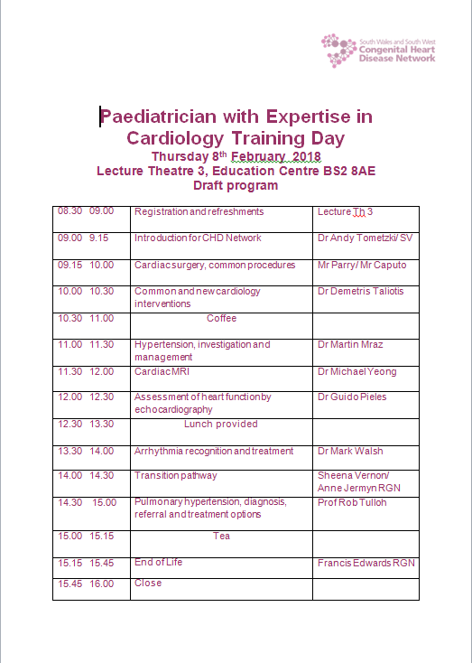

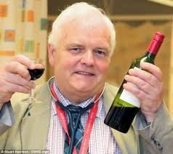
PEC training day
February 8th
Drinks afterwards Bristol Yard?
50 places

Slide 24
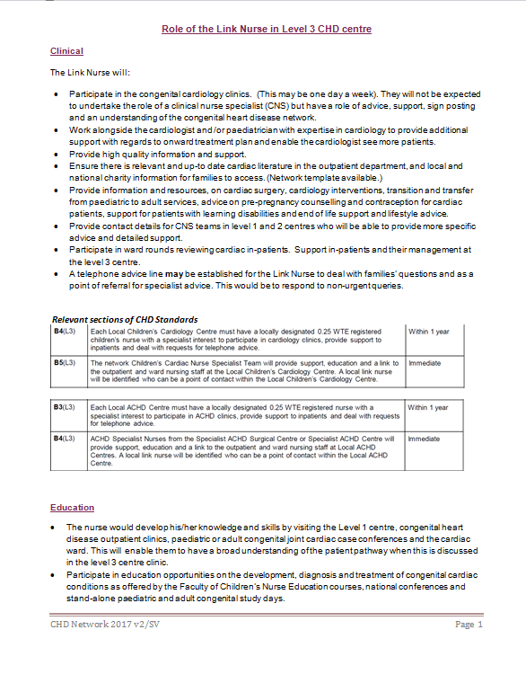
Link Nurses
8 paed link nurses
8 adult link nurses
Missing 3 managers from each nurse group
January 30th Network Nurses Day Level 1 and Level 2 Day
Level 3 to follow
Challenges
Covering ward AND clinic
Time pressures/funding for role

Slide 25
Network Risk Register Review
Risk description | Risk ID | Rating | Lead | Actions | Mitigations
Risk that Trust cannot secure funding from commissioners for the CHD Network | 1824 | 3 | VF | Continue negotiations with commissioners re future funding. NHS announcement 30/11 positive. | Trust has agreed to fund the Network team for 2017/18.
Risk that Network centres will be unable to identify or fund link nurses, reducing quality of service to patients | 2204 | 8 | SV | Options being explored with local teams. Link nurse development programme in place. Jan meeting | Plans to increase access to L1&2 centre nurses for high need patients.
Recruitment risk PEC – Torbay | 2304 | 6 | CM | Working on SLA to get external support as advert had no applicants. | Interim cover plans in place.

Slide 26
Network Risk Register Review
Risk description | Risk ID | Rating | Lead | Actions | Mitigations
Risk to effective delivery of paed cardiac care in Taunton due to absence of PEC | 2214 | 8 | CM | Business case agreed; recruitment to be taken forward. | Interim cover plan in place.
Risk to long term sustainability of CHD care in region due to lack of medical workforce in future/lack of succession plans. | 2191 | 8 | AT | Surveyed medical workforce. Discussed with Board. Take forward actions. | Local centres raising issues with board.
Risk of cancelled paediatric cardiac ops due to PICU capacity pressures | 2363 | 9 | CM | Write paper for board, recommending support for expansion. | Decisions to cancel ops not taken lightly. Clinical assessment made. Patients whose ops are cancelled are rebooked/tracked.

Slide 27
Network Incidents
Paediatric patient requiring urgent Level 1 Centre care transferred out of area (Southampton) due to lack of PICU capacity at BRHC
Reports of missed antenatal diagnoses x 5
16 yo acute A&E presentation, refused by adult cardiologists, refused by adult Clinical Decision Unit from A&E, admitted to paediatric ward but cardiac monitors were already in use and could not borrow monitor from coronary care. Finally borrowed from ITU. Not seen by any cardiologist as an inpatient. Referred to Level 2 centre.
Image sharing challenges – Taunton to Bristol (Form to follow)

Slide 28
Primary Care
Where do you see areas for closer working with primary care?
  Refresh/publicise referral guidelines for GPs?
  Develop Network e-training?
  ……………………………….?

Slide 29

A Call to Action
What does being a board member mean to you?

Slide 30
A Call to Action
  What can you commit to doing following today’s meeting?
  An audit at your Trust?
  Get involved in research?
  Become our Governance Lead?
  Develop your local palliative care directory?
  Identify and share incidents with us?
  Write GP training for CHD?
  Send your clinician profile to RB
  Lead or become part of a sub-group to help us move an area of work forward?
  …………….?

Slide 31
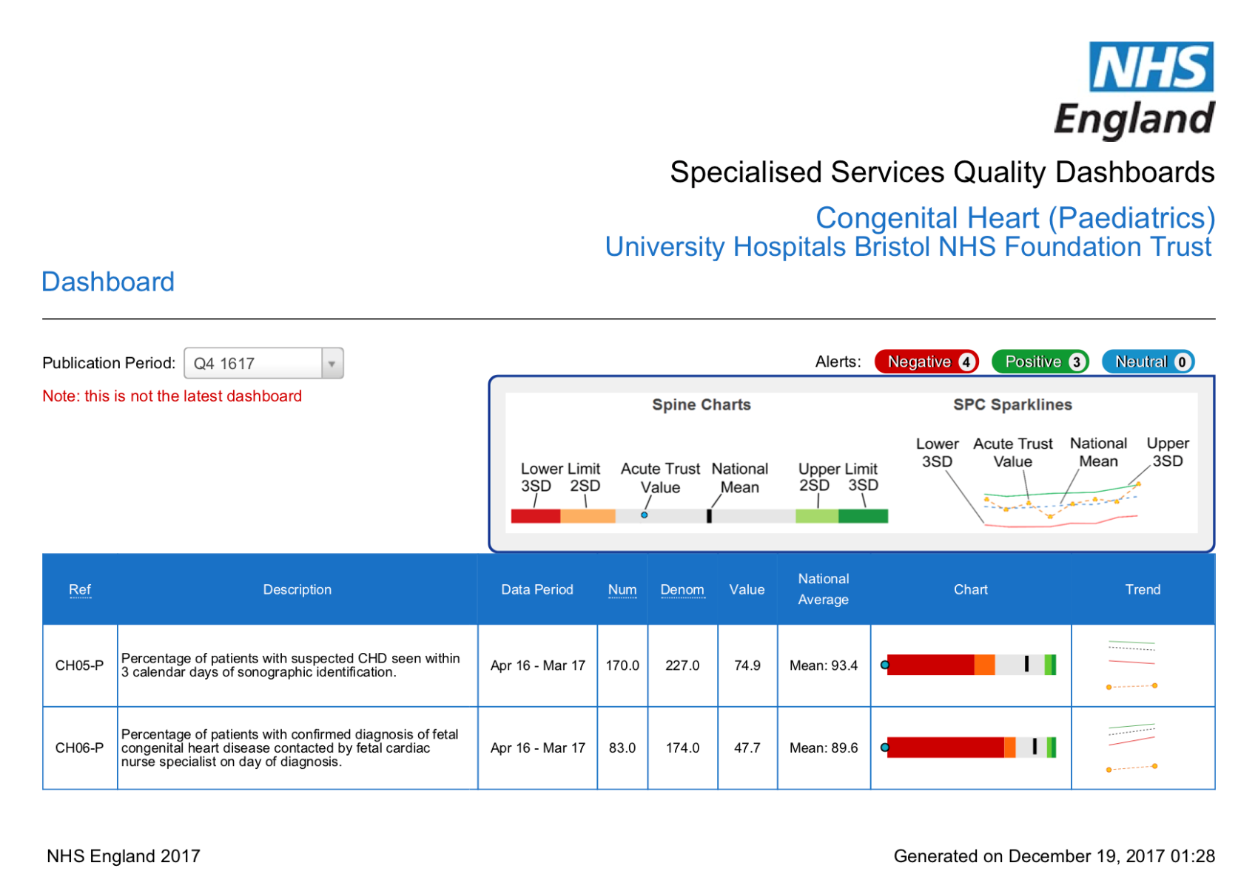
SSQD Dashboard - Paediatric

Slide 32
SSQD Dashboard

Slide 33
SSQD Dashboard - Paediatric

Slide 34
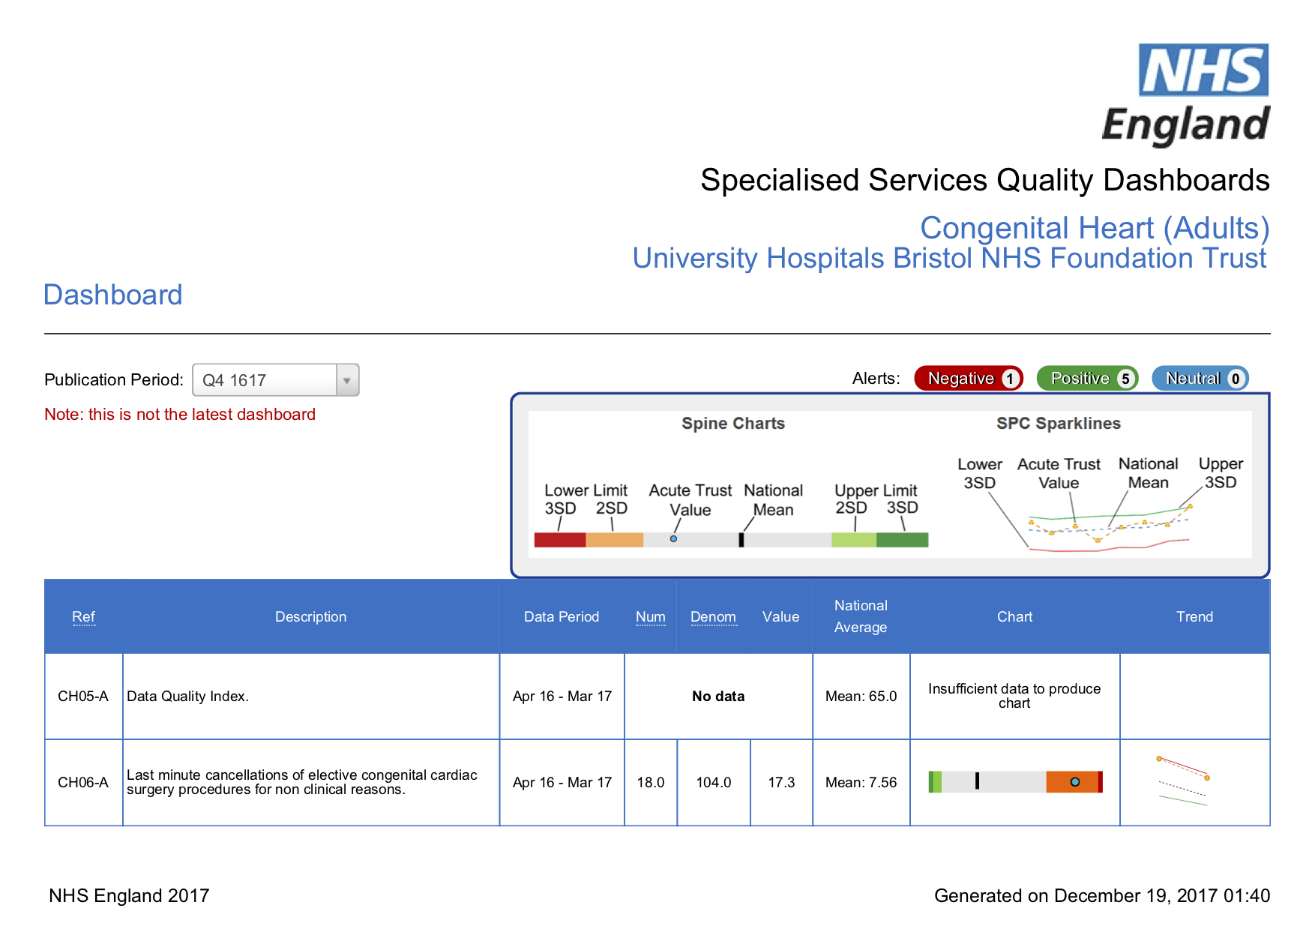
SSQD Dashboard - Adult

