Slide 1
Name Of Lesion

Slide 2
What is the lesion?
Basic anatomy

Slide 3
How is the Lesion Diagnosed
Initially at Infancy? – or can it be later on in adulthood i.e. PFO
What tests and ingestions?

Slide 4
What are the treatments?
I.e. Tran-catheter or Surgical.

Slide 5
Things Specific to think about with that lesion?
Are they High Risk of Endocarditis?
Is Pregnancy a high risk for that lesion?
Medicines – Will they need Warfarin?

Slide 6
Add Picture of Lesion from the Nevil Thomas ACHD Library
http://www.achd-library.com/

Slide 7
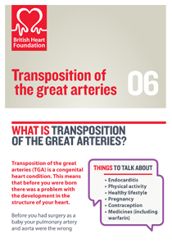
Have the British Heart Foundation “revealing the facts about your condition” – Information Leaflet

